Slide 1
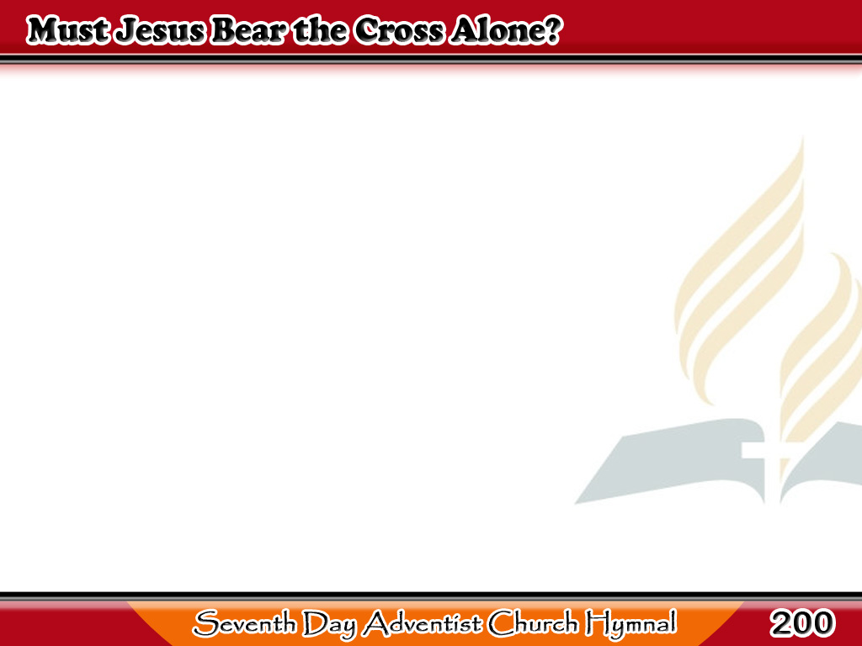
Sasarilinin Ba Niya?
Must Jesus bear the cross alone,
And all the world go free?
No, there’s a cross for every one,
And there’s a cross for me.
1/3

Slide 2
Sasarilinin Ba Niya?
The consecrated cross I’ll bear,
Till He shall set me free;
And then go home
my crown to wear,
For there’s a crown for me.
2/3

Slide 3
Sasarilinin Ba Niya?
Upon the crystal
pavement, down
At Jesus’ pierced feet,
3/3

Slide 4
Sasarilinin Ba Niya?
With joy I’ll cast
my golden crown,
And His dear name repeat.
3/3

